Slide 1
Data-Driven Insights
into U.S. Urban Housing
for Sustainable Smart Cities
Thesis Project
Merve Pakcan
Advanced Analytics for Business Master Program
Advisor: Prof. Monica Drăgoicea

Slide 2
TABLE OF CONTENTS
TIME SERIES & REGIONAL ANALYSIS
01
INTRODUCTION
05
02
DATA CLEANING
& PREPROCESSING
06
FEATURE ENGINEERING & MODEL DESIGN
03
EXPLORATORY DATA ANALYSIS
Dataset Description, Quality Control & Data Cleaning
Linear Regression, Random Forest, Decision Tree,
Gradient Boosting
07
PRICE FORECASTING
Time series modeling for future price prediction
Descriptive Statistics, Distribution Analysis, Correlation Analysis, Normality Assessment
08
CONCLUSION

Slide 3




INTRODUCTION
Rising housing costs and urban challenges force people to reconsider where and how they live.
PROBLEM
Apply data analytics to uncover housing trends and guide sustainable urban choices.
1.What factors drive home sale prices across U.S. urban regions?
2.How do affordability and competitiveness shape urban housing dynamics?
3.How effectively can machine learning models predict housing market dynamics?
GOAL
RESEARCH QUESTIONS

Slide 4

DATA PREPROCESSING & CLEANING
DATASET DESCRIPTION
10500 ROWS & 12 COLUMNS
Variables
RegionID
RegionName
RegionType
StateName
Date
Dependent Variable
Median Sale Price
Independent Variables
Pct Sold Above List
Median Rent
Market Heat Index
YearsToSave
SaleToListRatio
NewCon Median Sale Price
The data is obtained from Zillow Research, a public platform that provides comprehensive, regularly updated datasets on the U.S. housing market.
Data span: March 2018 - February 2025.
Challenges in Data Gathering
Bucharest data unavailable due to privacy restrictions

Slide 5
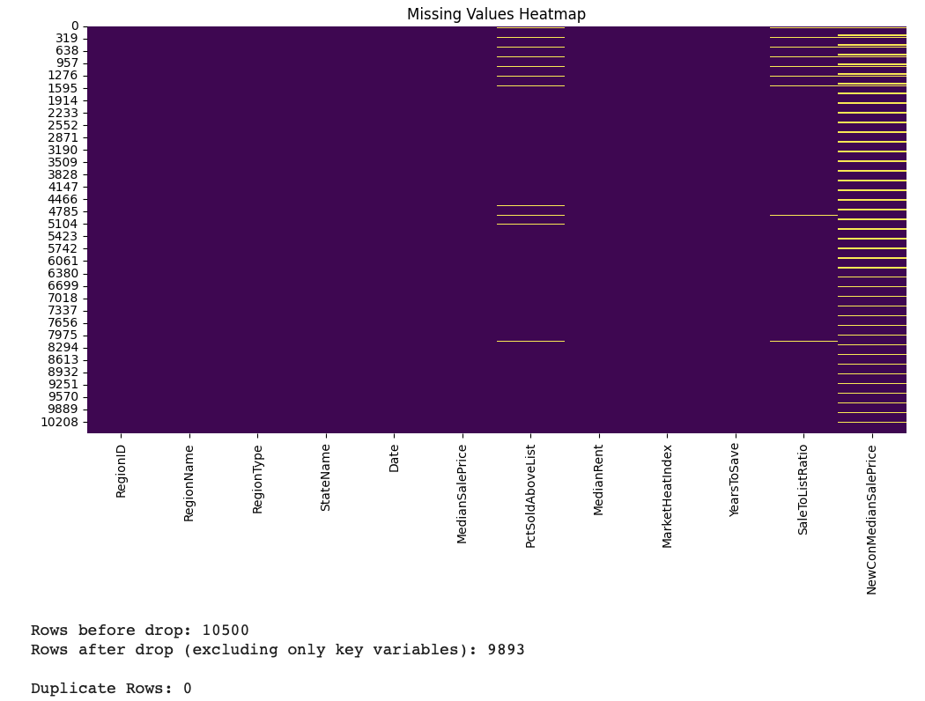
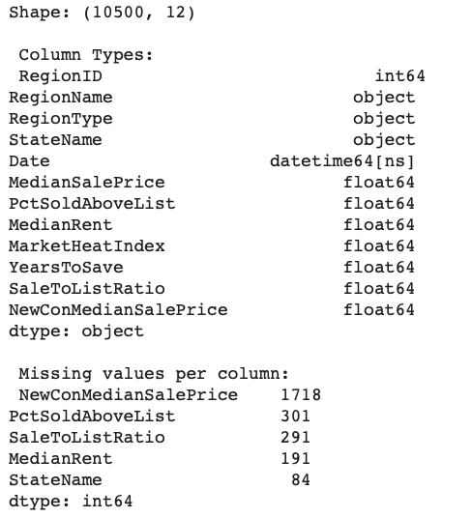
QUALITY CONTROL & DATA CLEANING
Data Types
Not dropped missing in Newcon
Missing Values
No duplicate
10500 ROWS —> 9893 ROWS

Slide 6
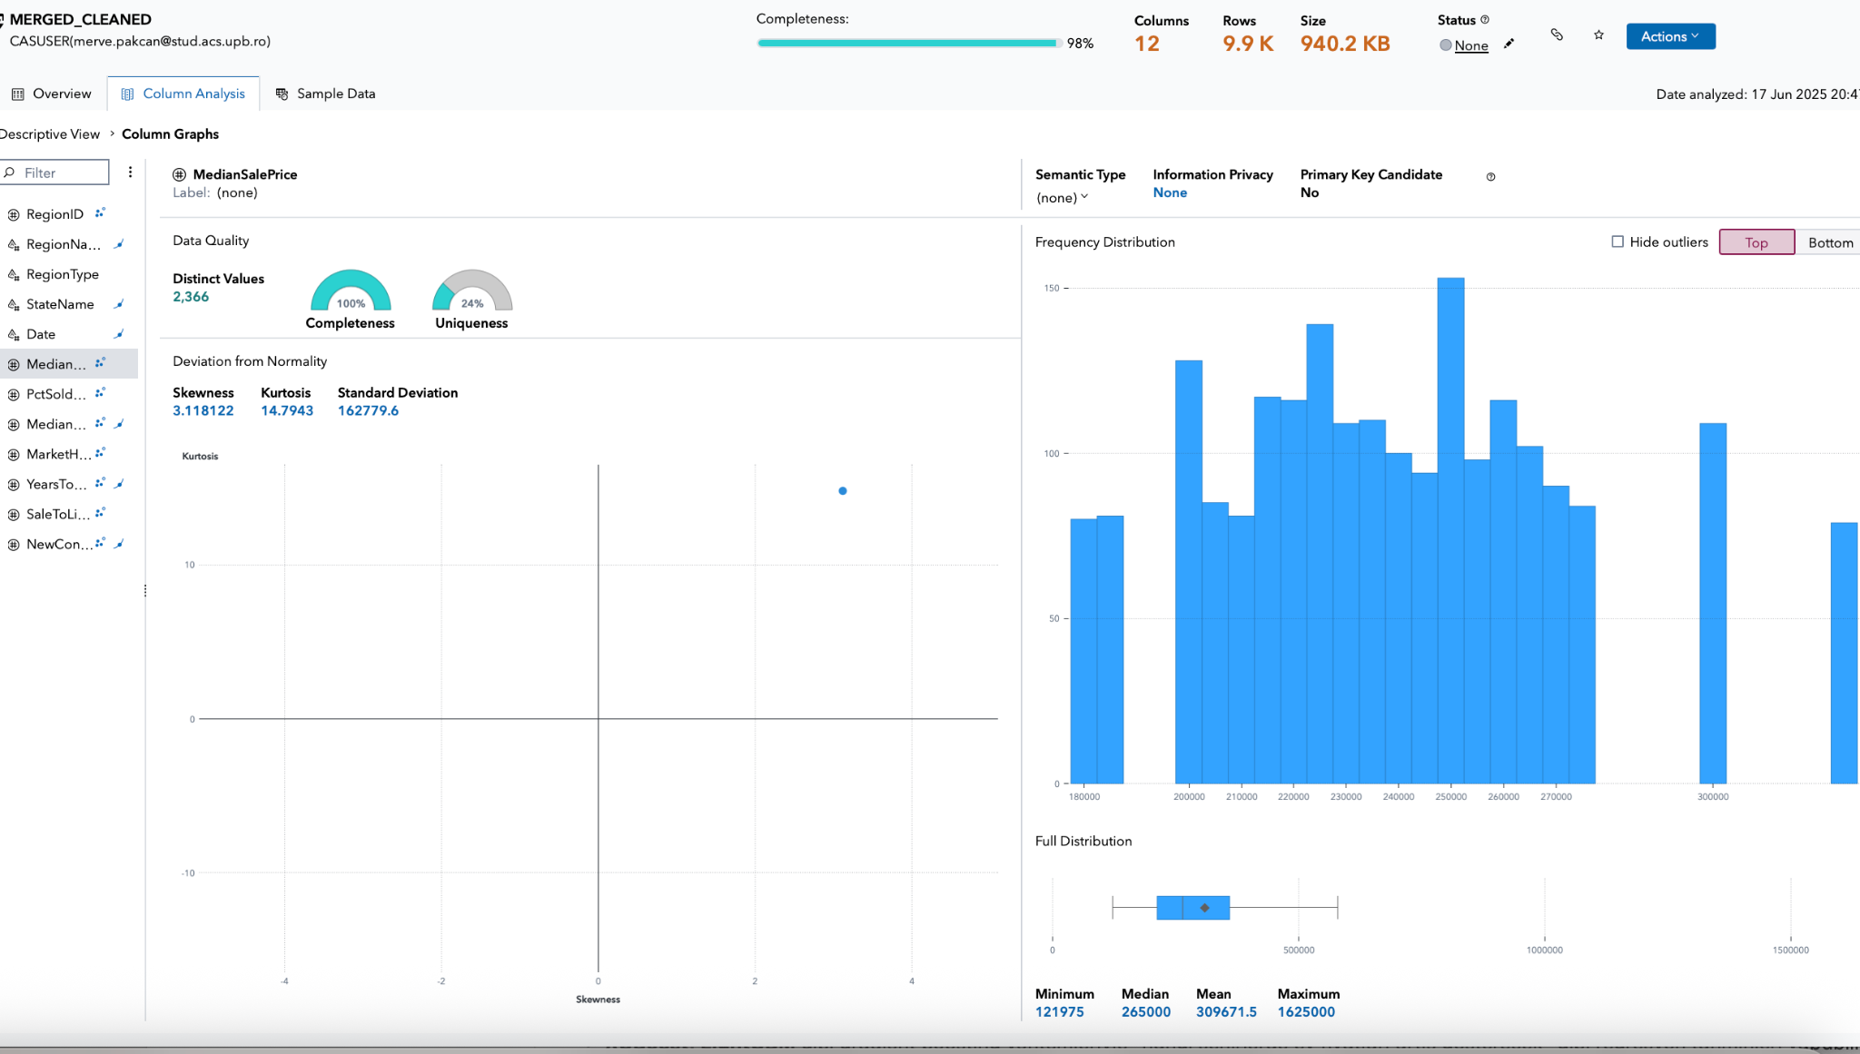
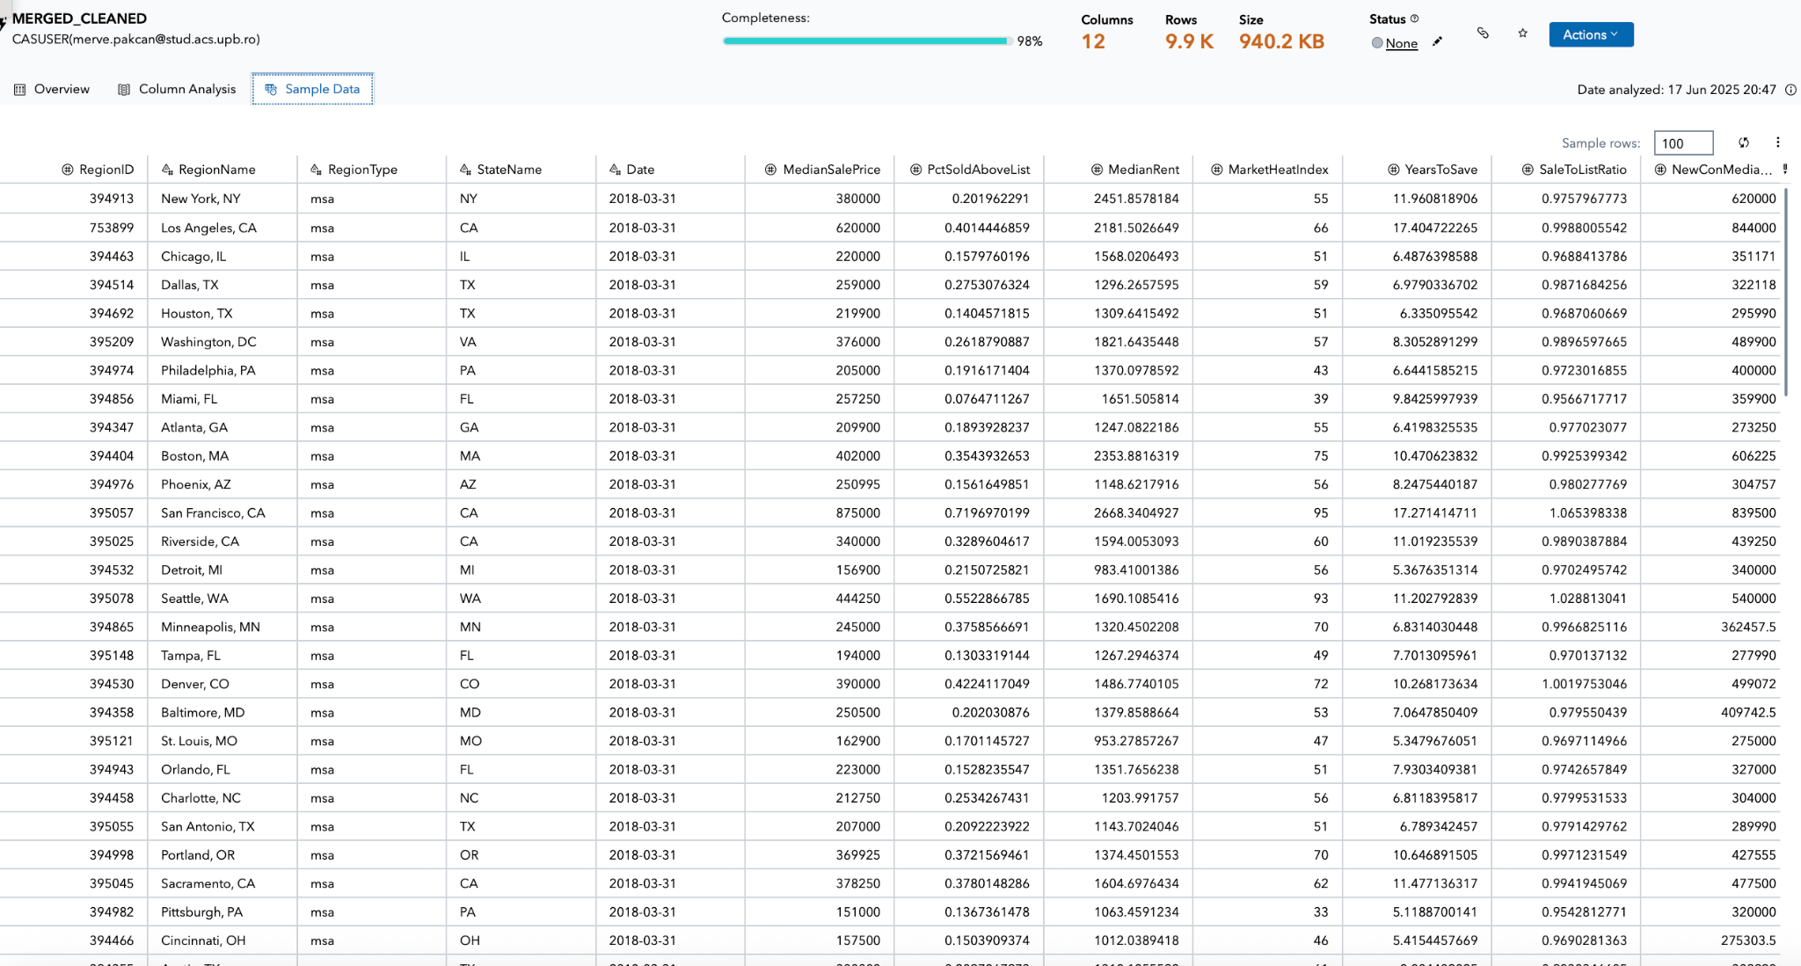
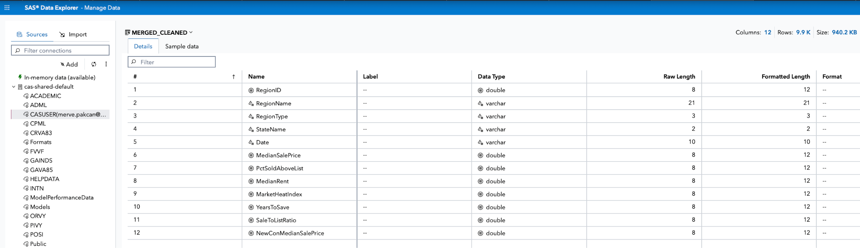

Slide 7
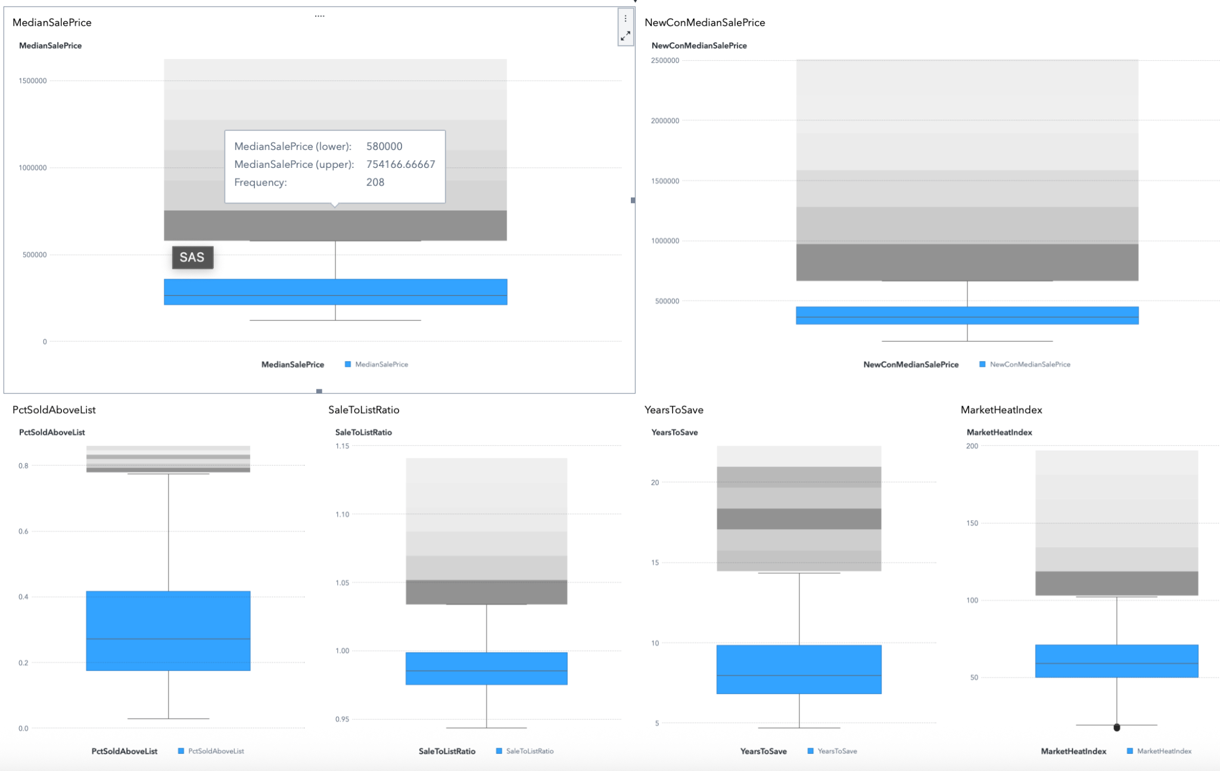
Outliers
Not dropped outliers, it is meaningful

Slide 8
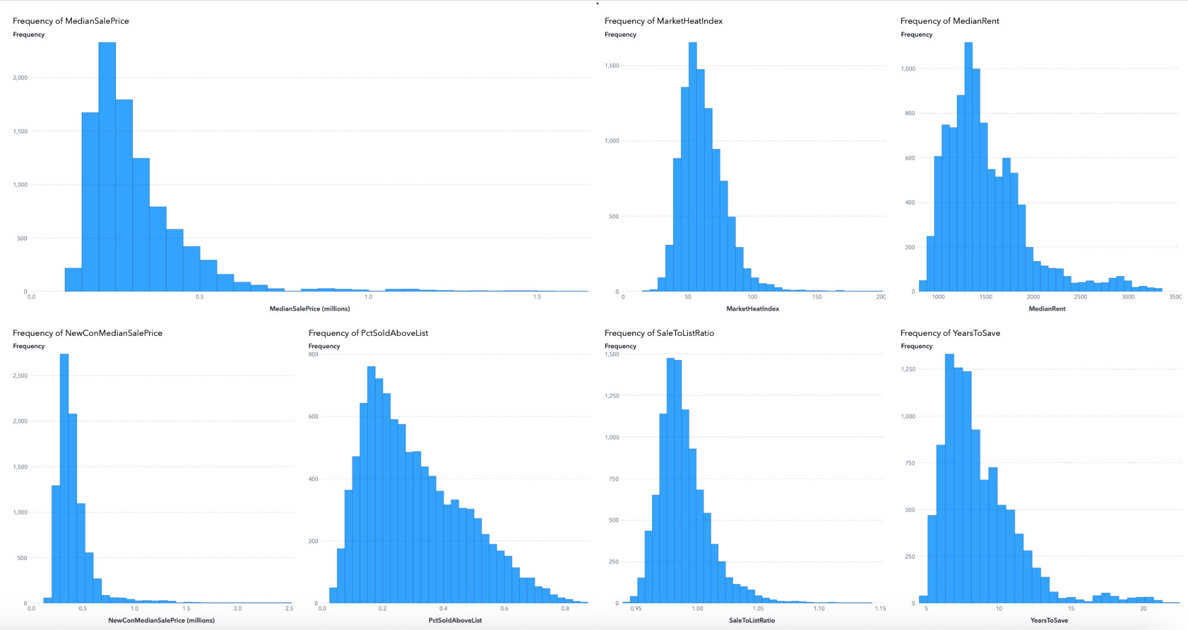
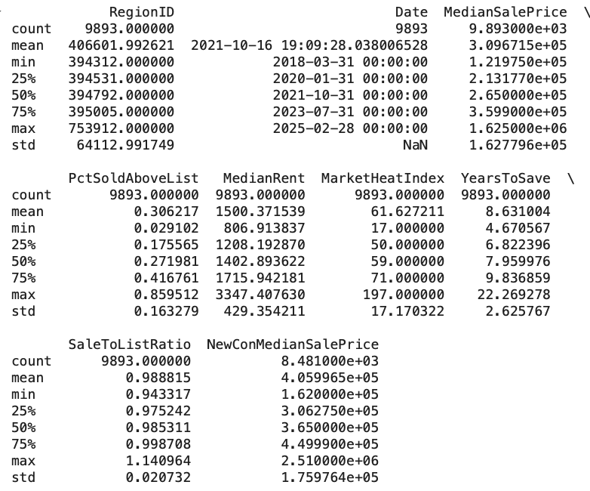
EXPLORATORY DATA ANALYSIS
Distribution Analysis via Histograms
Descriptive Statistics

Slide 9

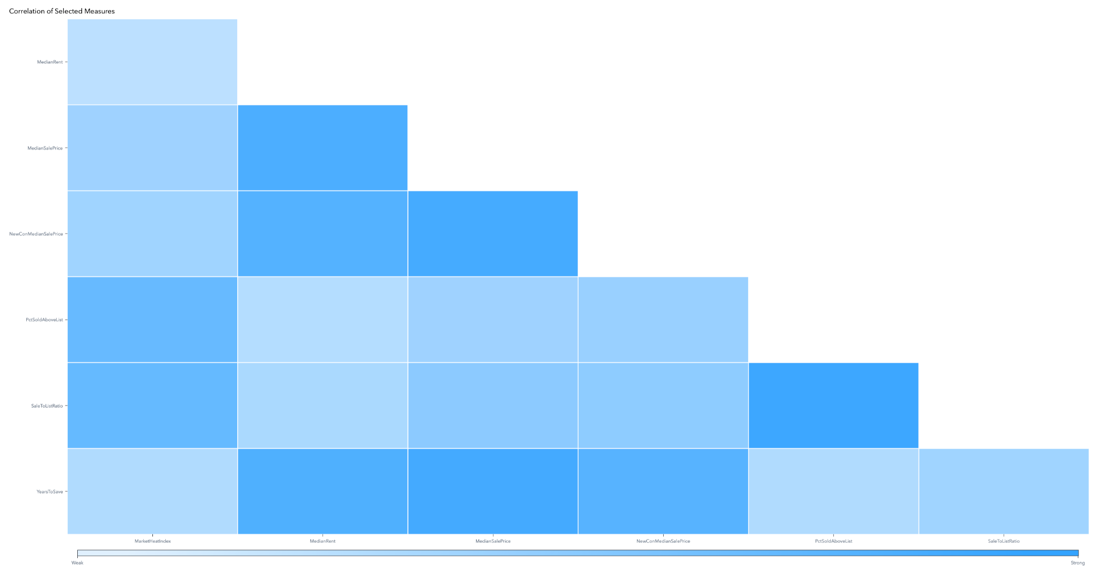
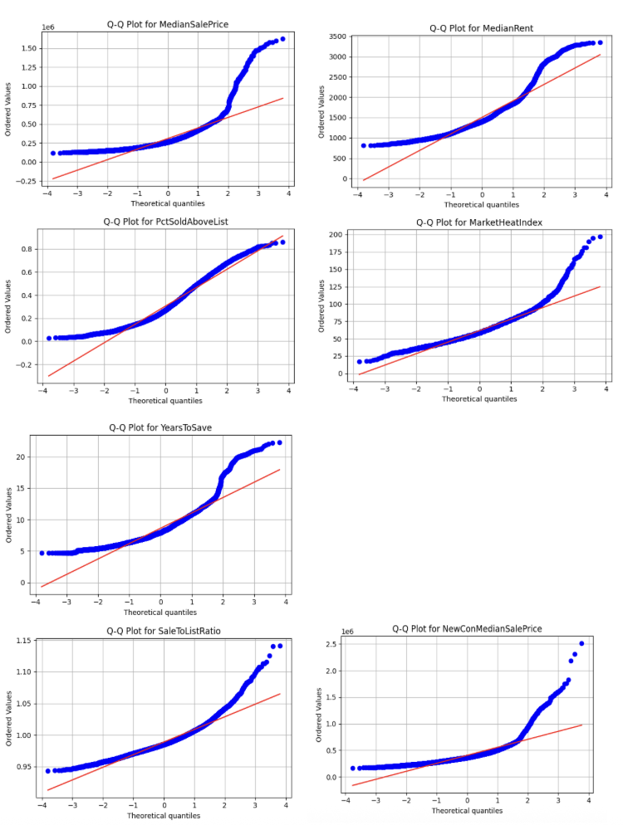
Correlation Analysis & Q-Q Plot
Median Sale Price ↔ Median Rent
Median Sale Price ↔ Years to Save
Market Heat Index ↔ Pct Sold Above List
Most variables deviate from normality, as expected in housing data

Slide 10
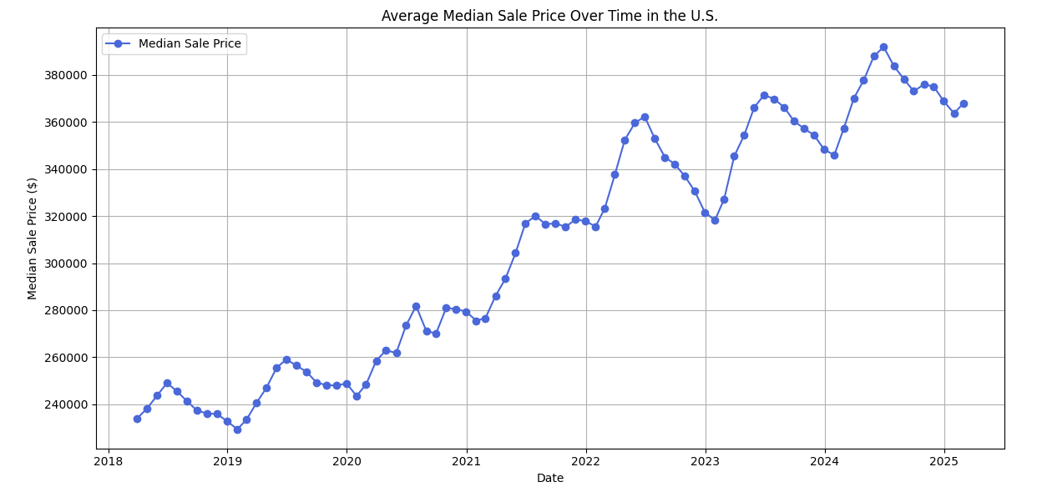
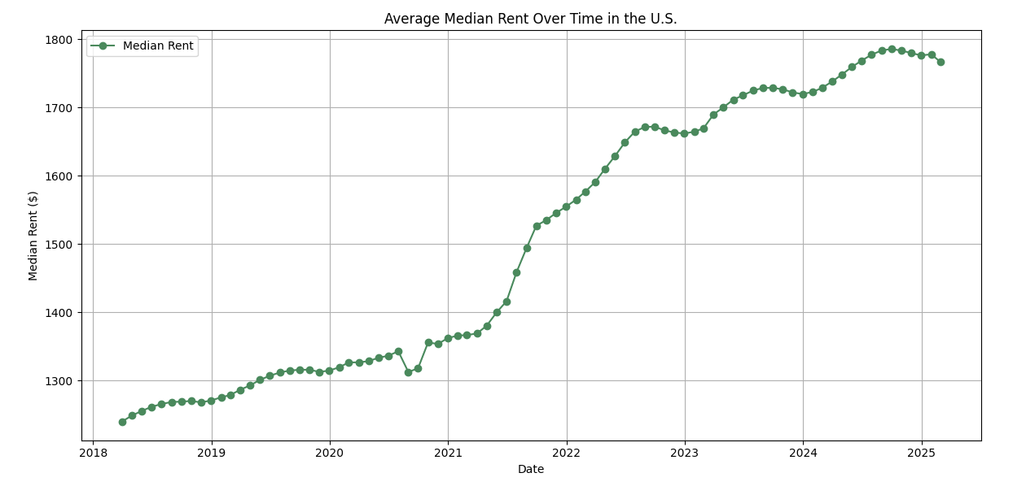
TIME SERIES ANALYSIS
Average median sales over time
Average median rent over time
Steady upward trend, with sharper increases during 2021–2022

Slide 11
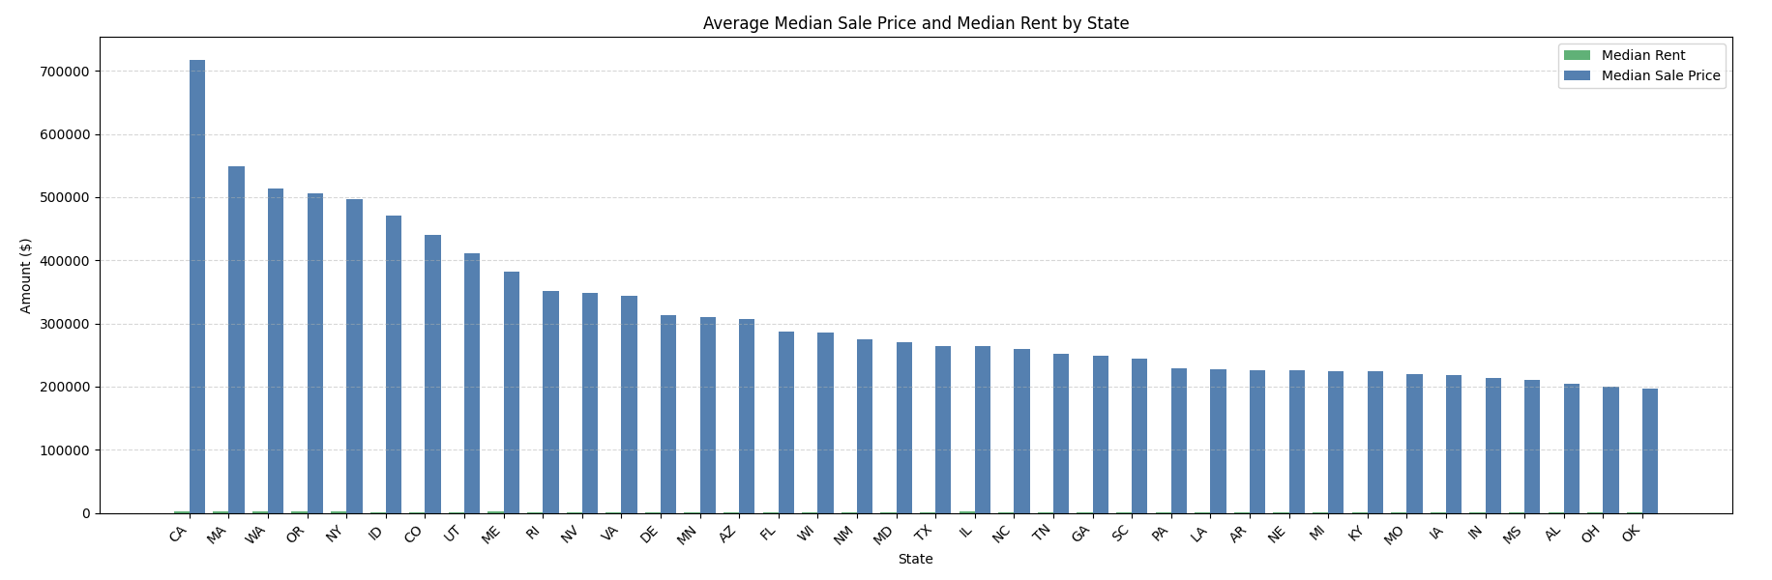
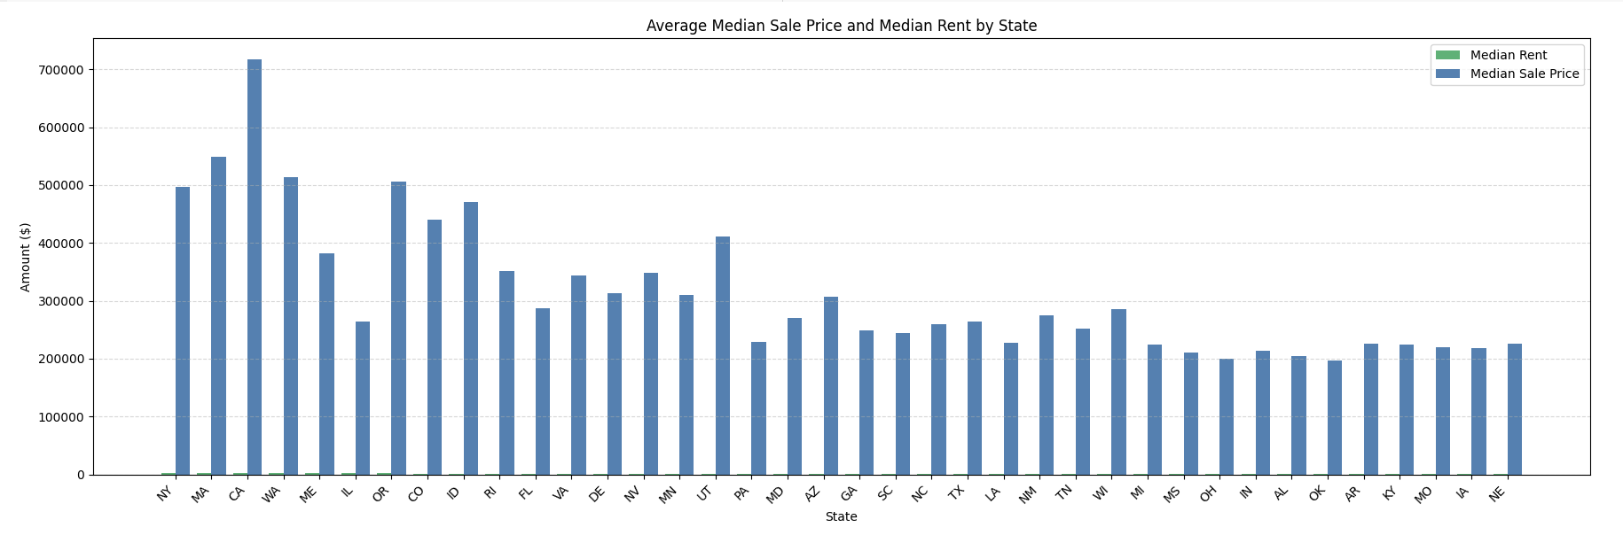
REGIONAL ANALYSIS
Sorted By Median Sale Price
Key States
California
New York
Washington & Massachusetts
Idaho & Utah
Oklahoma & Mississippi
Sorted By Median Rent

Slide 12
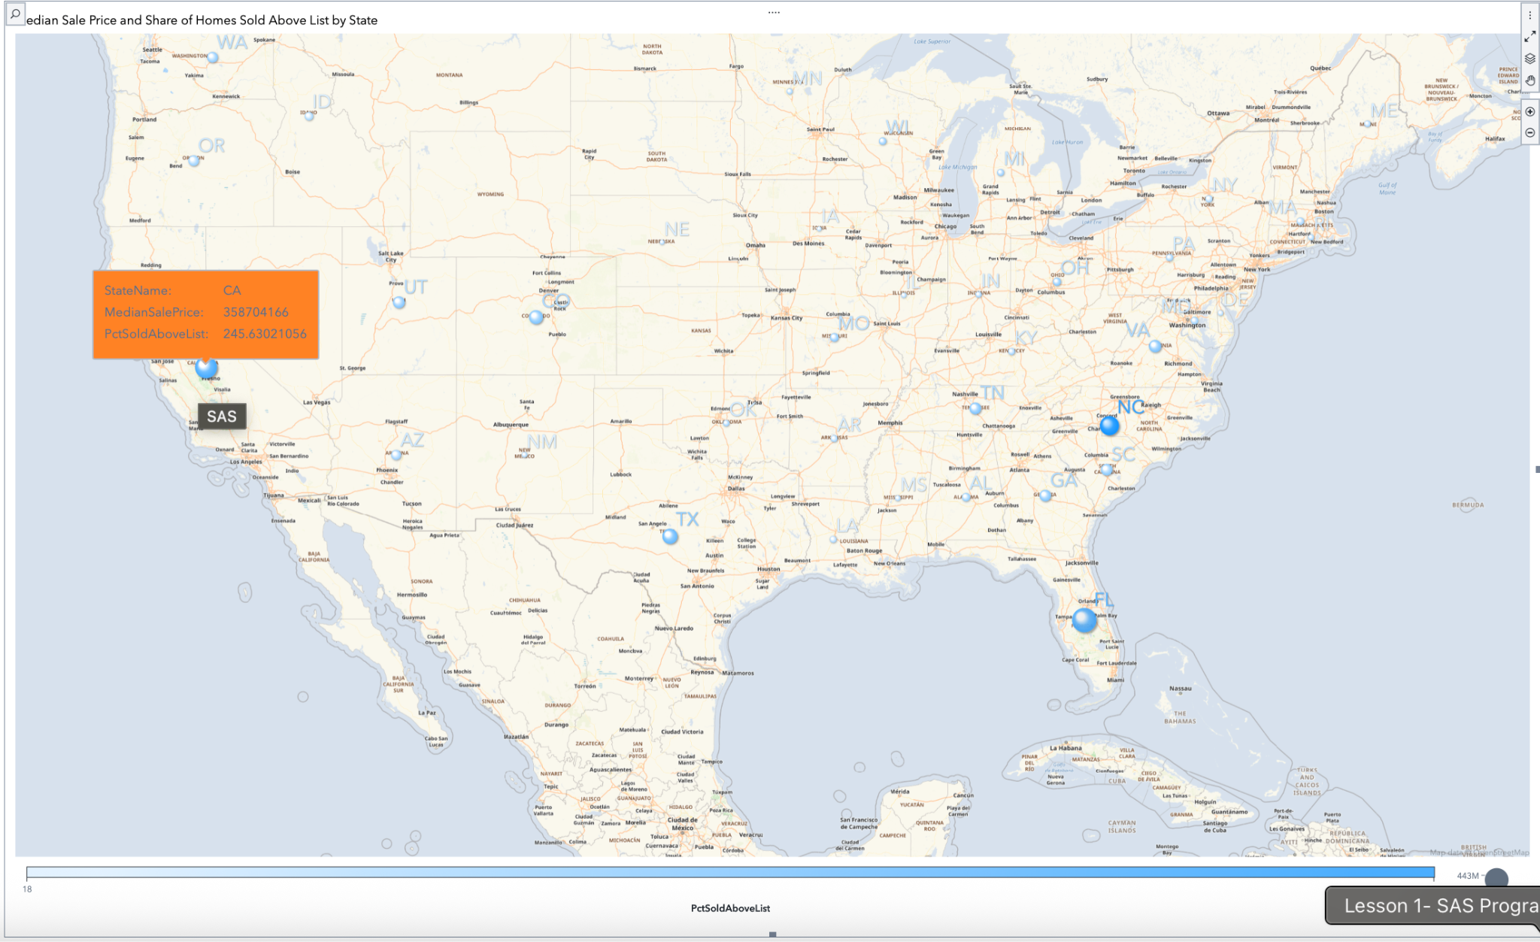
Mapping Regional Housing Disparities
Bubble size = Median Sale Price
Color intensity = % of Homes Sold Above List
Geo Bubble Map / SAS

Slide 13
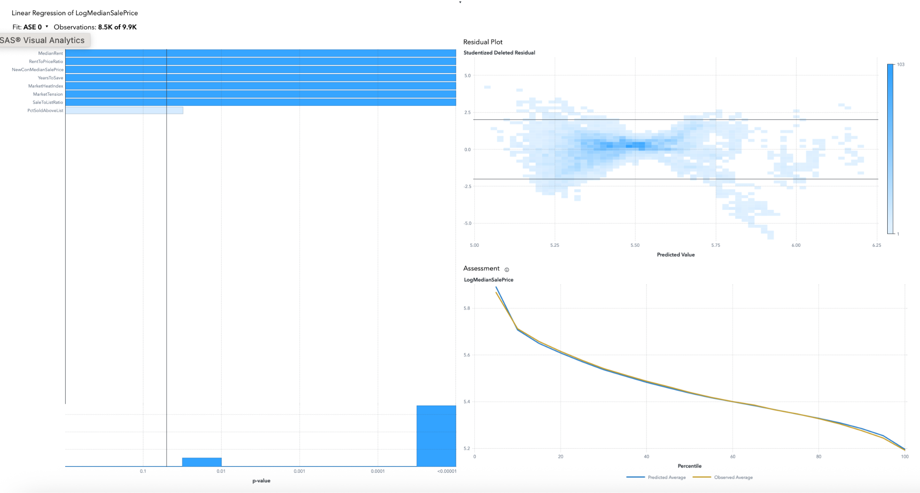
FEATURE ENGINEERING & MODEL DESIGN
New Variables: Rent To Price Ratio, MarketTension, LogMedianSalePrice
1.LINEAR REGRESSION
Simple baseline. Captures main trends, struggles with complex patterns

Slide 14
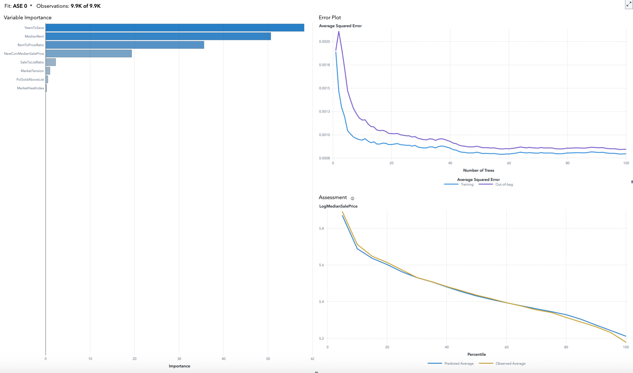
2. RANDOM FOREST
Captures complex patterns with high accuracy. Key drivers: YearsToSave, MedianRent.

Slide 15
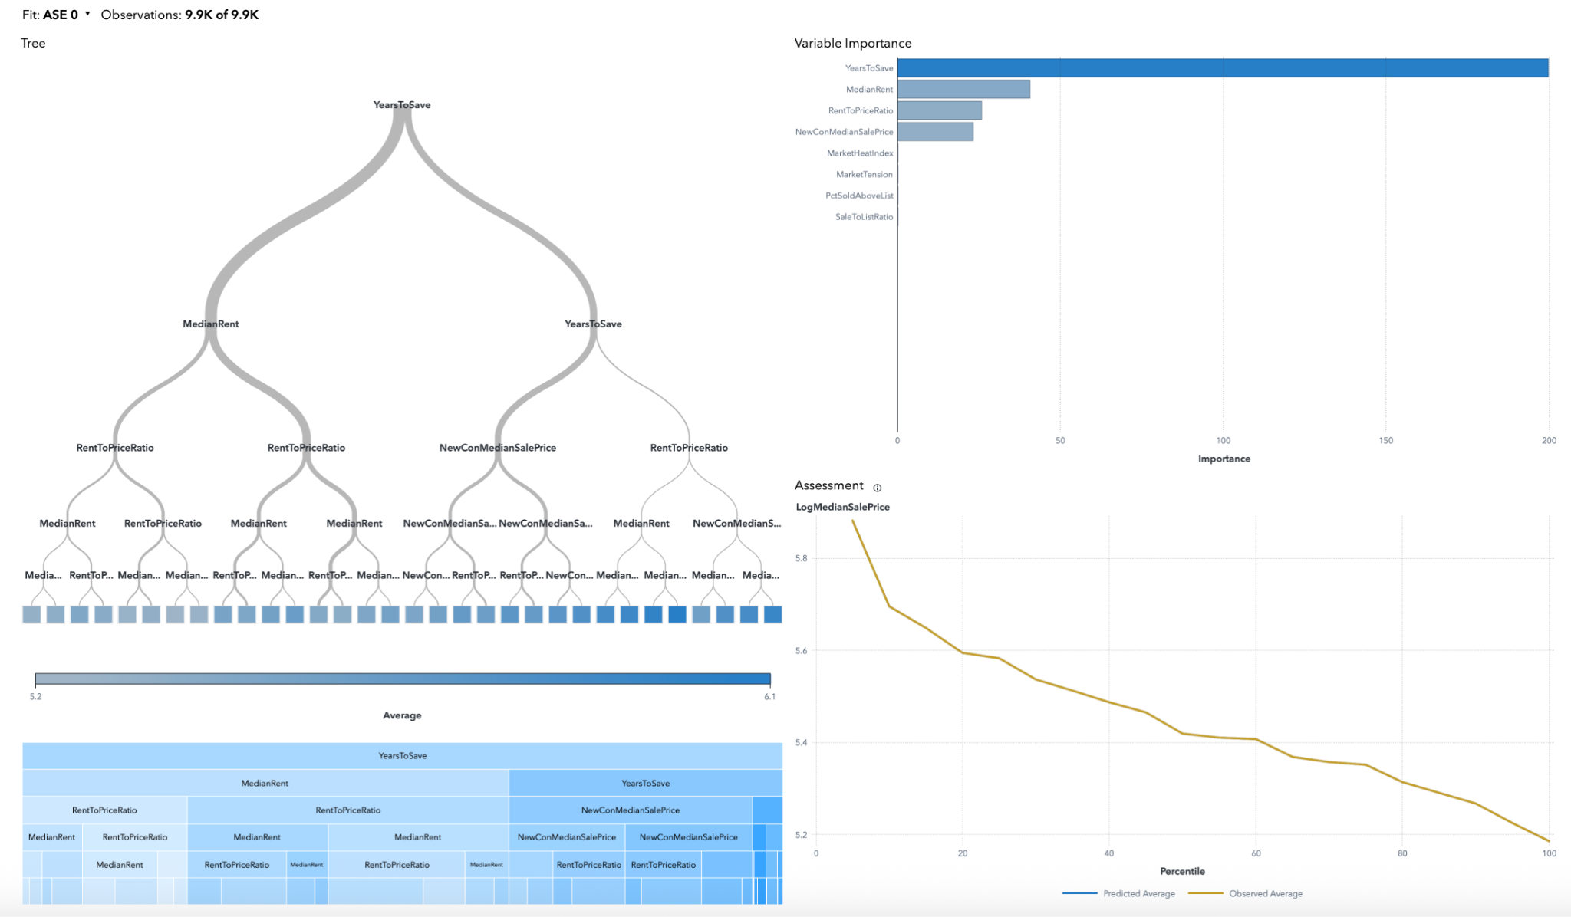
3. DECISION TREE
Simple and interpretable, but prone to underfitting. Useful for visualizing splits.

Slide 16
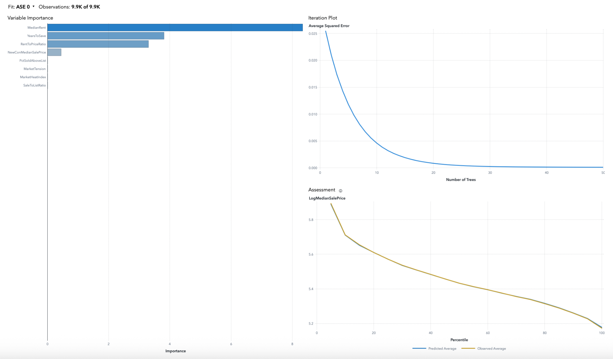
4. GRADIENT BOOSTING
Best performing model. Strong fit, fast convergence, robust to outliers.

Slide 17
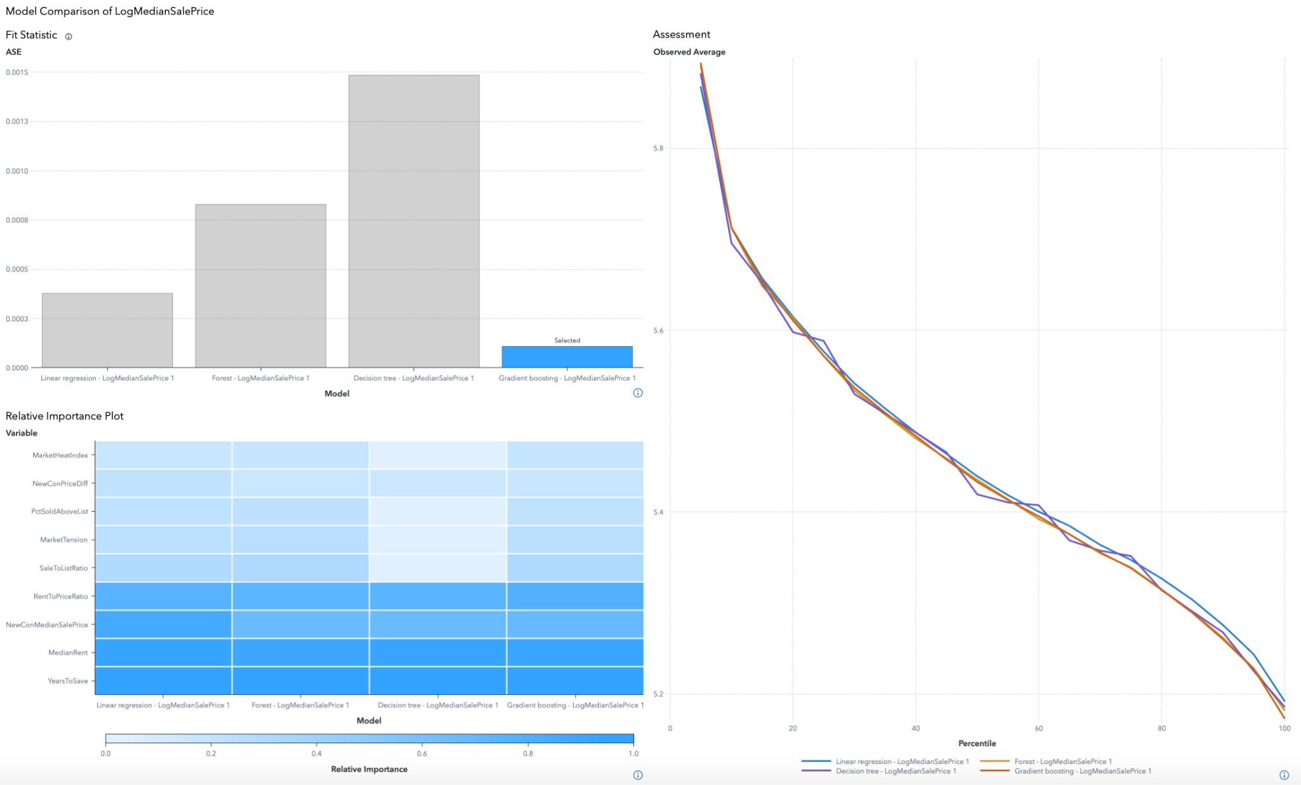
MODEL COMPARISON
Best fit: Gradient Boosting Lowest error Top variables: Rent & YearsToSave Advanced Models (GradientBoosting, RF)> Simpler Models(Decision Tree, Linear Regression)

Slide 18
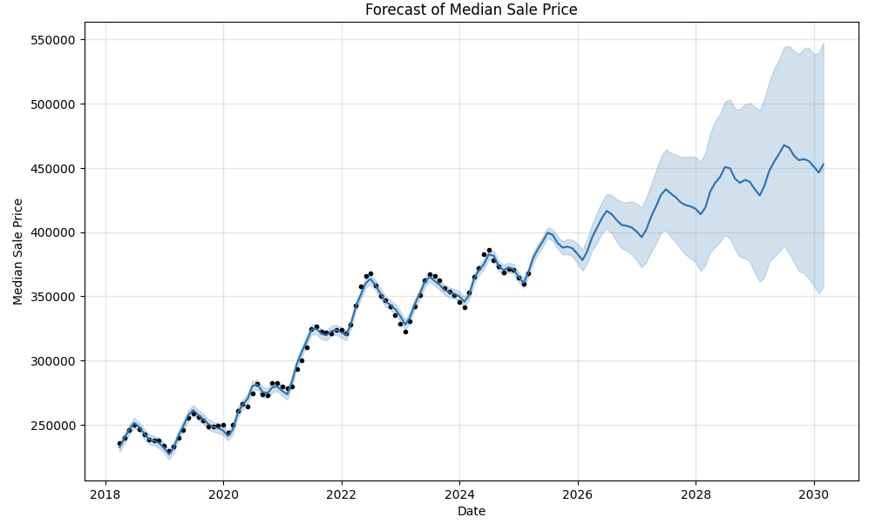
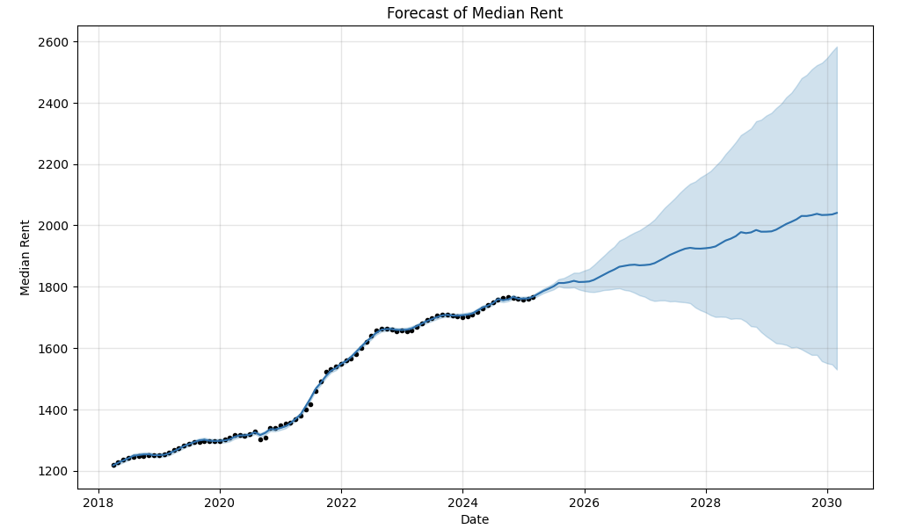
PRICE FORECASTING WITH PROPHET
5 YEAR FORECAST

Slide 19
CONCLUSION
What insights can we draw from all this?
Q1: What drives housing prices? Rent and years to save are top drivers.
Q2:How do affordability and competition shape housing? Regional trends and time series confirm growing affordability issues.
Q3: Can machine learning predict housing dynamics? Gradient Boosting showed best performance and predictive power.
Machine Learning models revealed useful patterns. Future work: Adding climate/pollution data,trying advanced forecasting(like graph neural network), creating a recommender system.

Slide 20
THANKS FOR LISTENING!
Do you have any questions?

